Slide 1
Customer
Churn Prediction
Steven Kusuma - FTDS Batch 015

Slide 2
Table Of Content
Objective and Model
2. Dataset
3. Exploratory Data Analysis
4. Data Preprocessing
5. Model Evaluation
6. Sample Testing
7. Deployment App Demo

Slide 3
Objective
Model :
With 2 API :
An Artificial Neural Network Model to predict that a customer will churn or not
ANN
Sequential API
Functional API

Slide 4
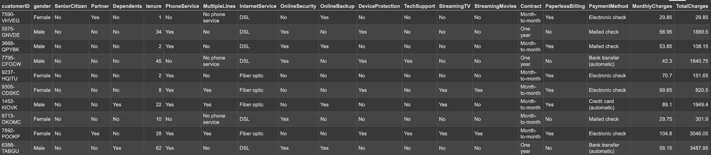
Dataset
Data consists of 7,043 rows and 21 columns. 3 columns are integers, and 18 columns are string.
https://www.kaggle.com/datasets/blastchar/telco-customer-churn

Slide 5
Exploratory Data Analysis

Slide 6
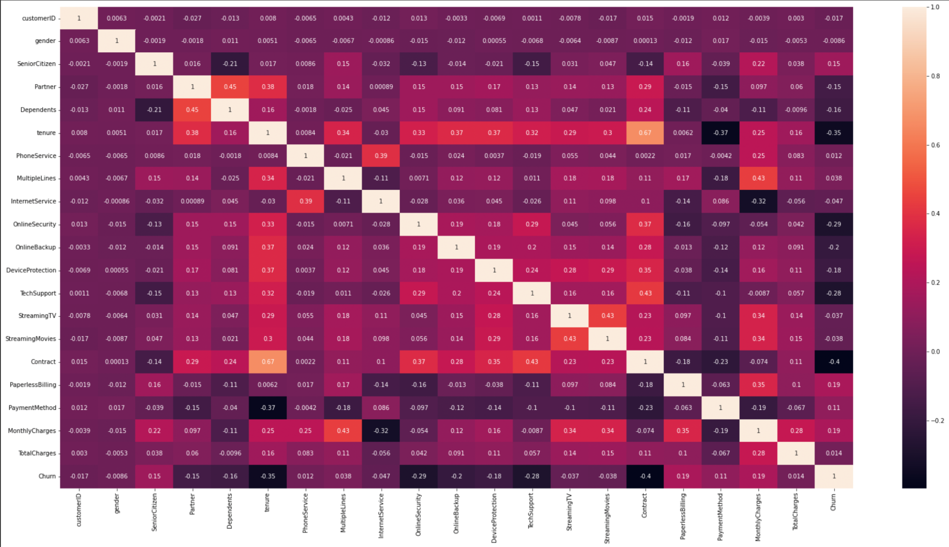
Correlation Matrix

Slide 7
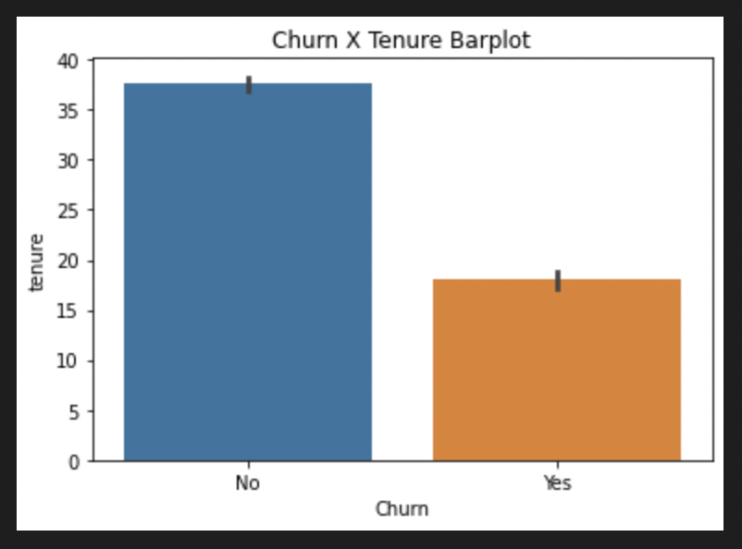
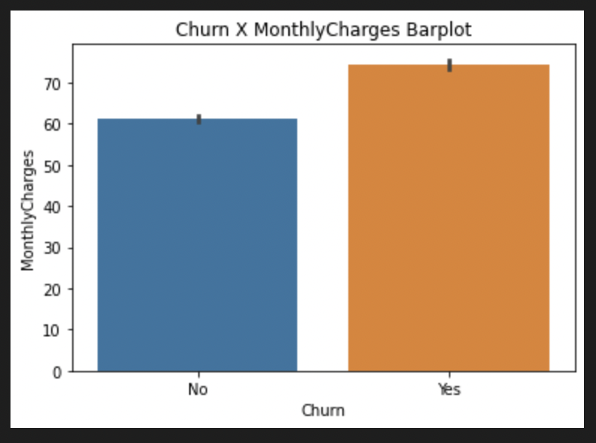
Lower tenure indicates that customer will churn
Higher MonthlyCharges indicates that customer will churn
What Triggers Churn?

Slide 8
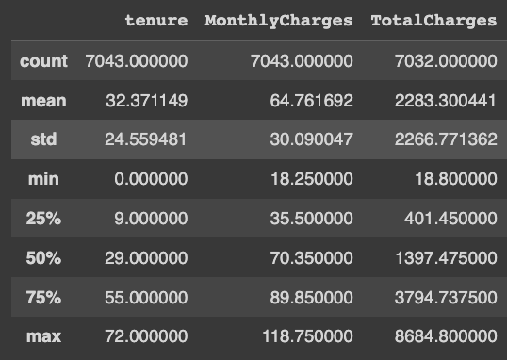
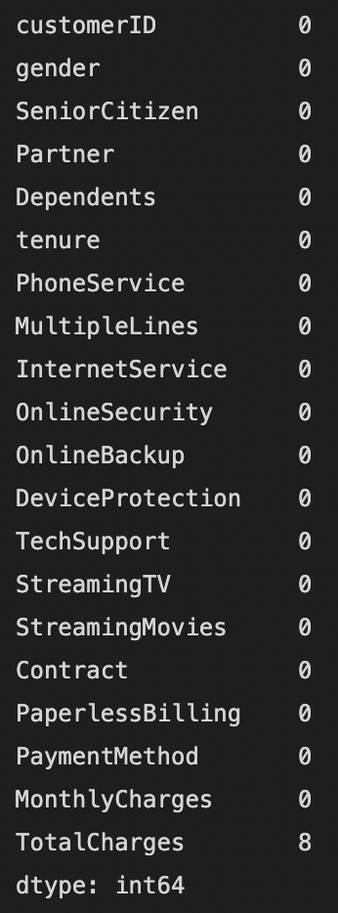
Data Preprocessing
Handling
Feature
Outliers
Missing Values
Scaling
Encoding
MinMaxScaler
OneHotEncoder
As the mean and 50% is not significantly different, data is fairly normally distributed. Therefore no handling outliers are needed.
Missing Values to handle

Slide 9
Model Evaluation

Slide 10
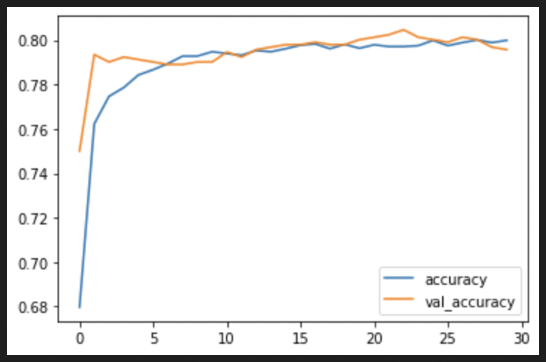
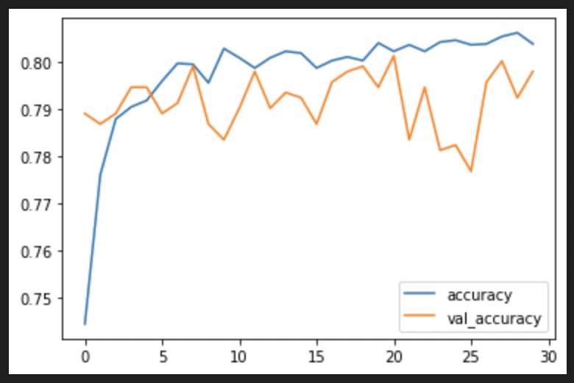
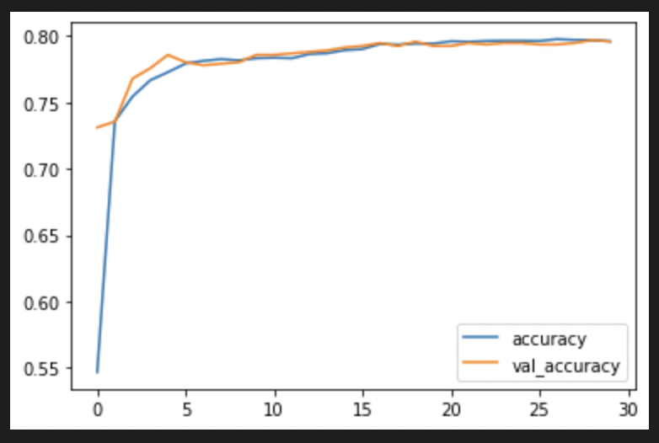
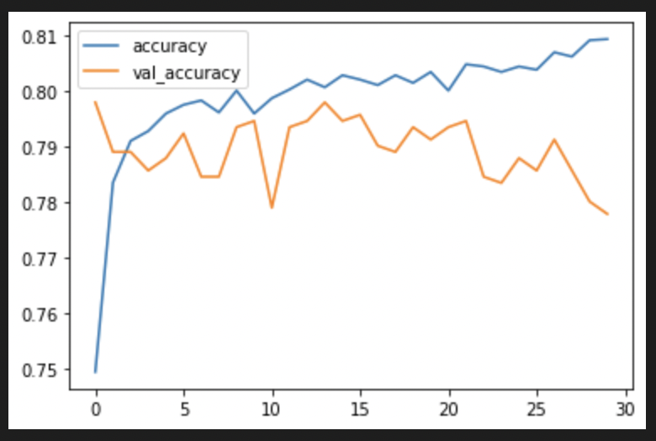
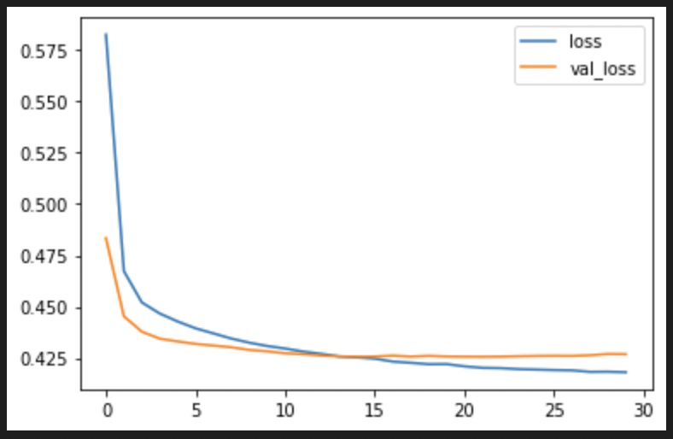
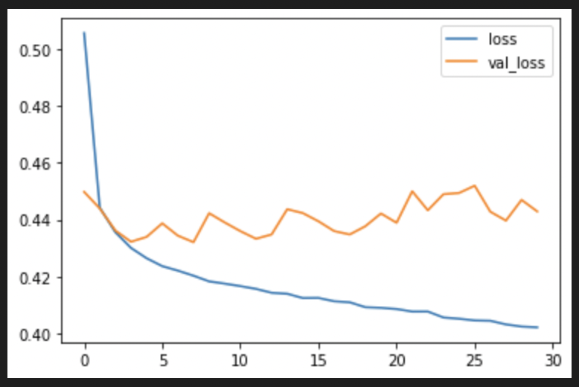
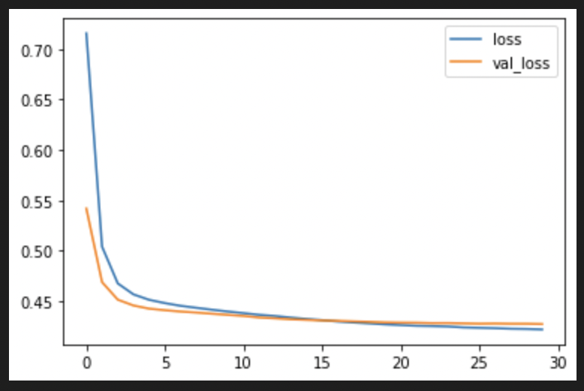
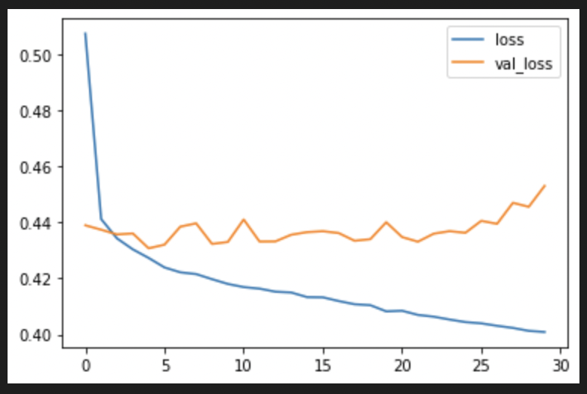
Sequential API
Functional API
Baseline
622 Parameters
Improvement
4,719 parameters
Baseline
487 Parameters
Improvement
3,683 Parameters
Accuracy
Loss

Slide 11
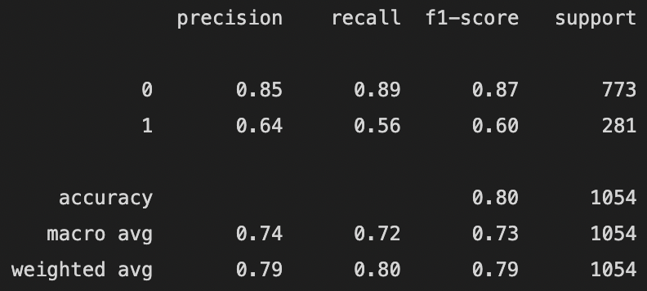
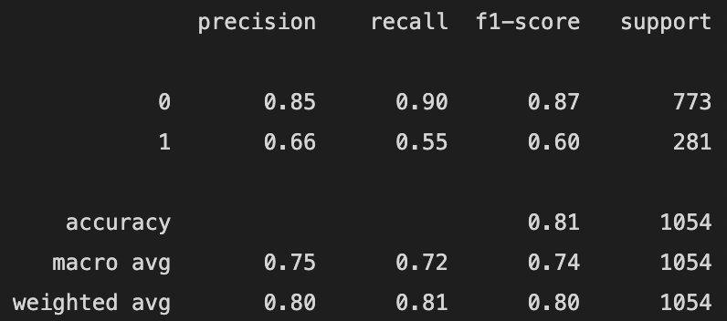
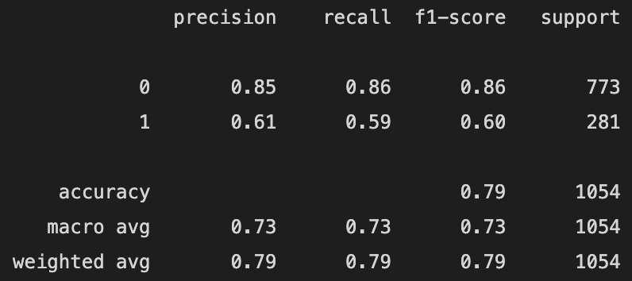
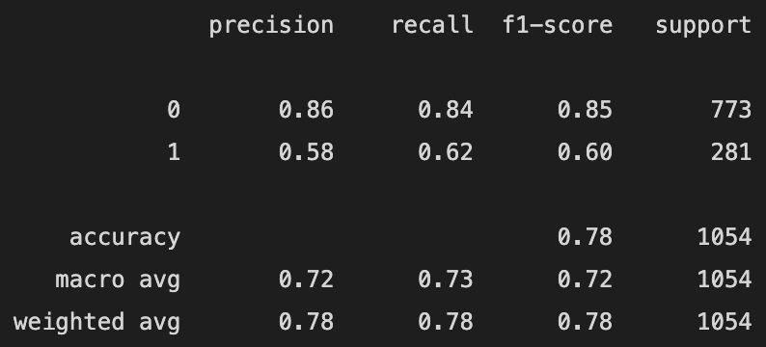
Classification Report
Sequential API
Functional API
Baseline
Improvement

Slide 12
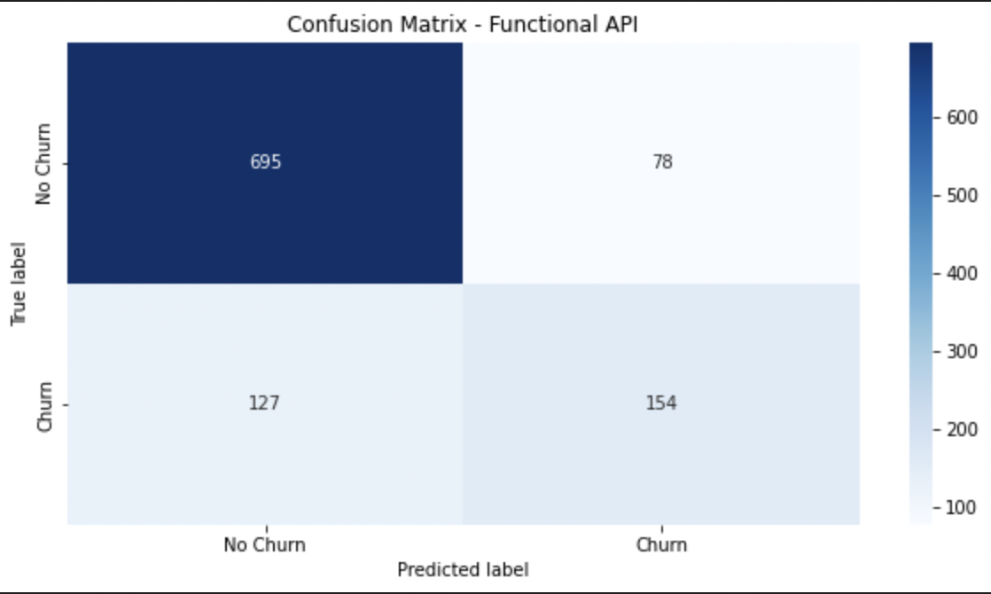
Functional API - Baseline
Test Accuracy level : 81%
This API predicts Churn target correctly by 55%
The main concern is as if :
True label = Churn
Predicted label = No Churn
as a result might get a Churned customer, may give wrong or may not give a promotion.

Slide 13
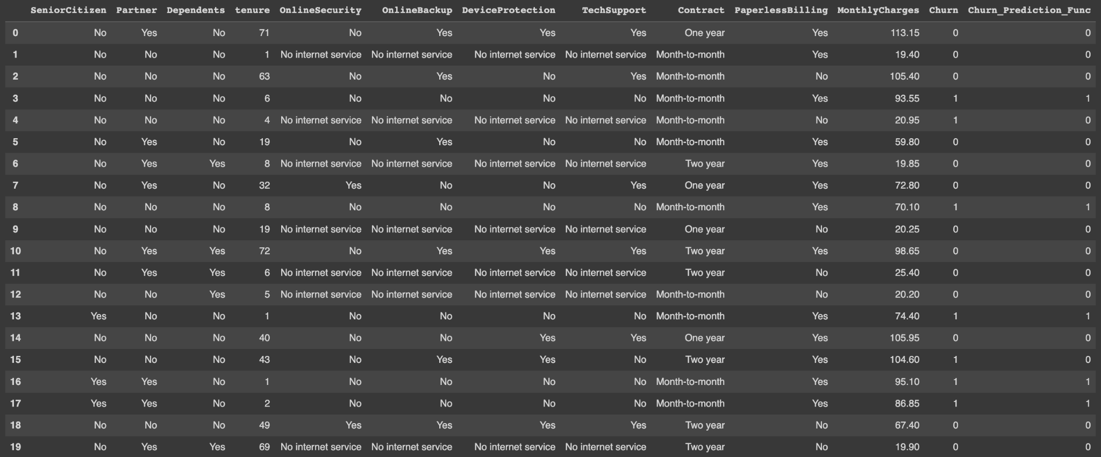
Sample Testing using Functional API - Baseline
2 out of 20 samples wrongly predicted.
True Label
Predicted Label

Slide 14
Deployment App Demo
True Label
Predicted Label
https://churn-frontend-v1.herokuapp.com/

Slide 15
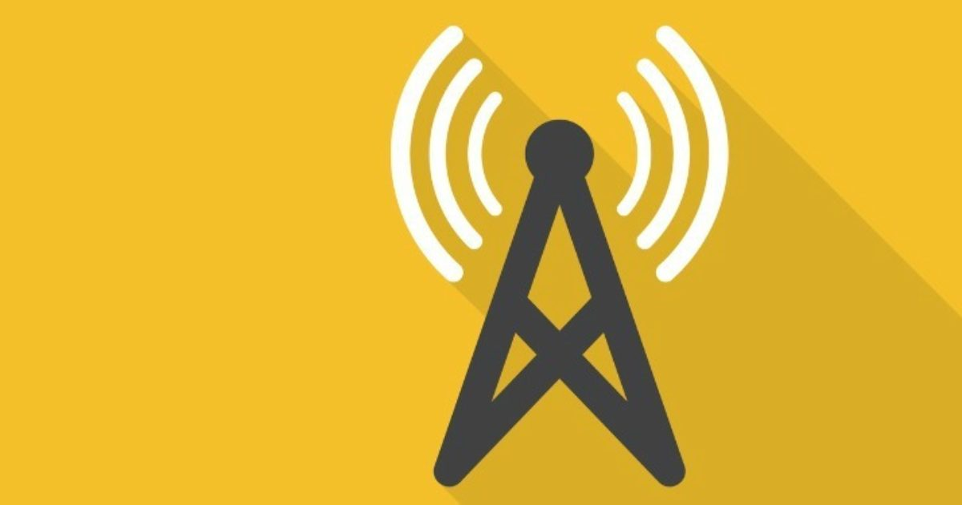
Thank you!

